Slide 1

DTSA 5510
Final Project

Slide 2
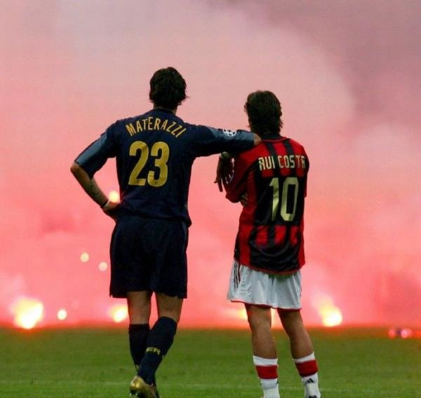
Project Agenda
1. Project Introduction
2. Data Cleaning
3. Exploratory Data Analysis
4. Cluster and Classification
5. Conclusion

Slide 3
1. Project Introduction
Dataset
FIFA23 1st Edition Player Database
From Kaggle Website
Players’ Information and Attributes
Goal
Explore the positions of players
based on their attributes
and accurately predict them.

Slide 4
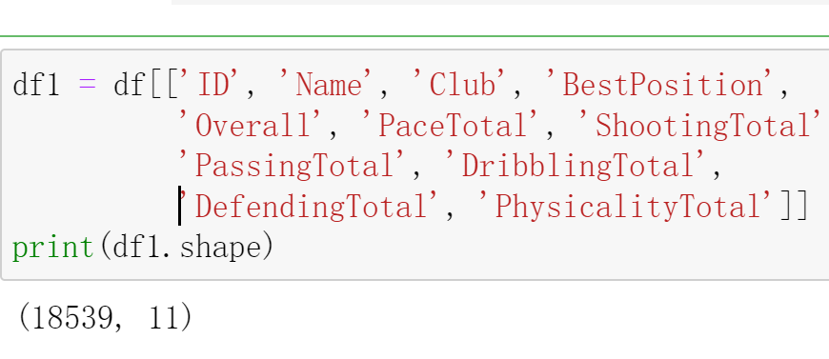
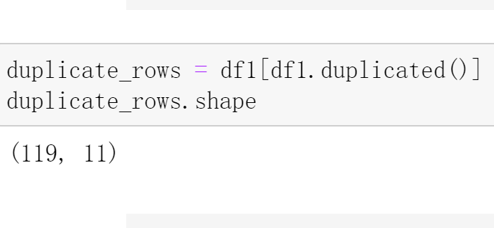
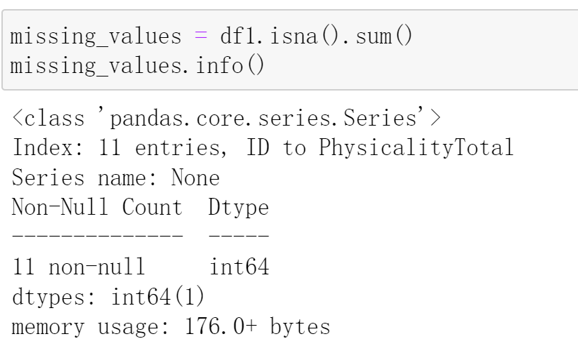
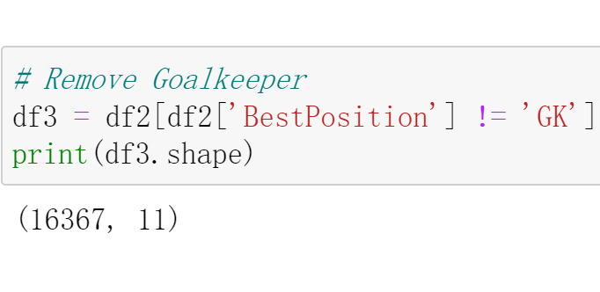
2. Cleaning Steps
Feature Selection
Delete Duplicates
Checking Missing Value
Subset Selection

Slide 5
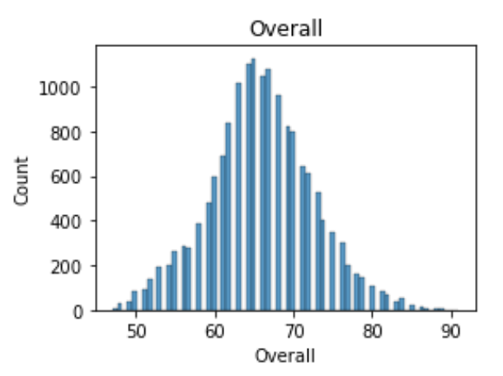
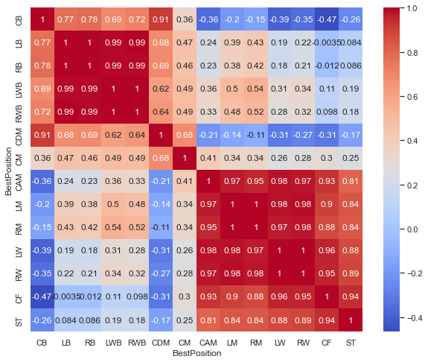
3. Exploratory Data Analysis
Distribution
Correlation

Slide 6
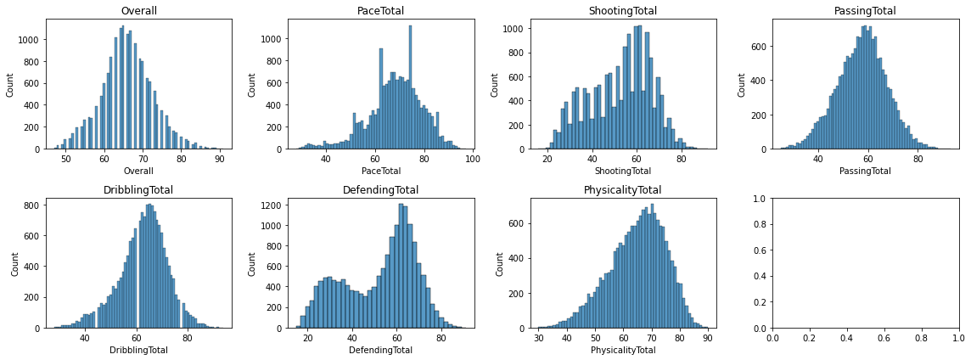
3.1 Attribute Distribution
General attribute is very likely to be able to predict the position.

Slide 7
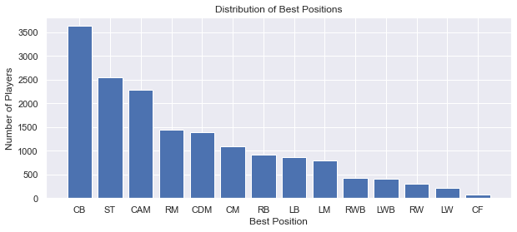
3.2 Position Distribution
Based on the understanding of the real world, many positions on the soccer field are similar to each other.

Slide 8
3.3 Position Correlation
Heat Map shows the strong correlation between positions.
Positions should be clustered by the nature of similarities within the dataset.

Slide 9
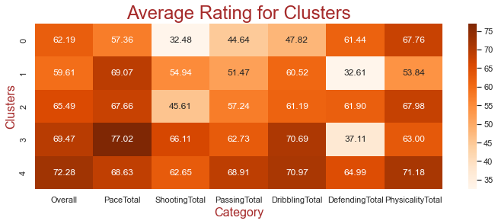
4.1 First K-means Clustering
The significant difference in the average Overall Rating among the five clusters of players indicates that:
K-means algorithm prioritizes the classification of players with different overall levels rather than grouping them based on the distribution of their attributes.

Slide 10
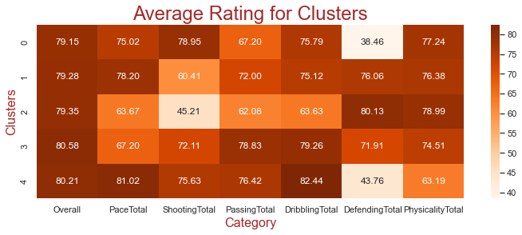
4.2 Second K-means Clustering
Narrow Down the number of players to Top 1000.
K-means algorithm perfectly grouped the players into five categories, and each category of players has different tendencies in their attributes.

Slide 11
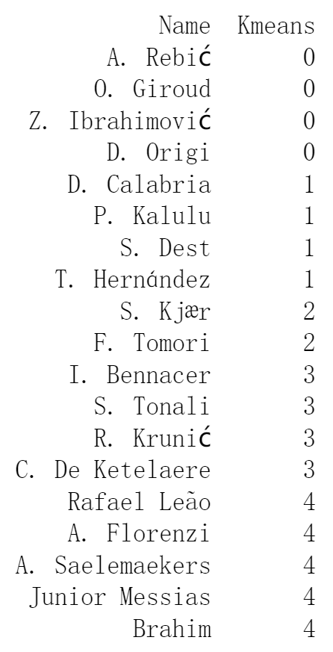
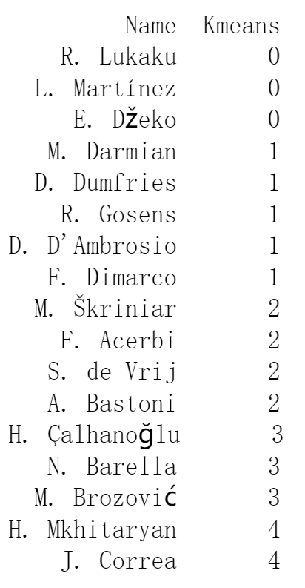


4.3 Double Checking

Slide 12
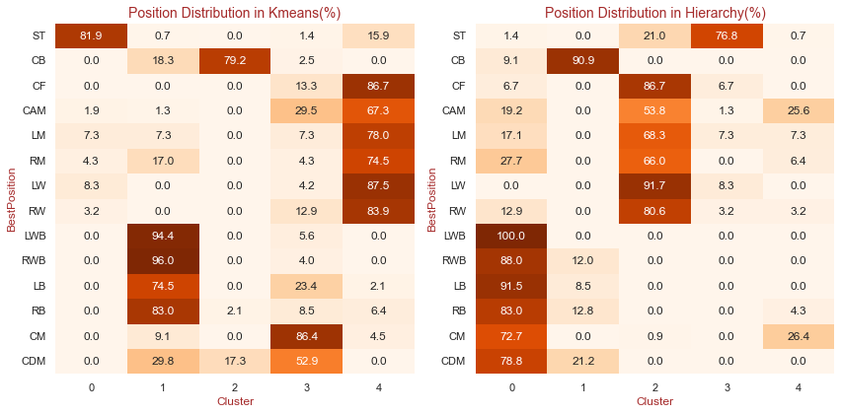
4.4 Compare to Hierarchy Clustering
In K-means clustering, the positions of players in each cluster are very focused and concentrated.
In Hierarchy, Cluster 0 and 2 intersect with each other, and cluster 5 has no meaning.

Slide 13
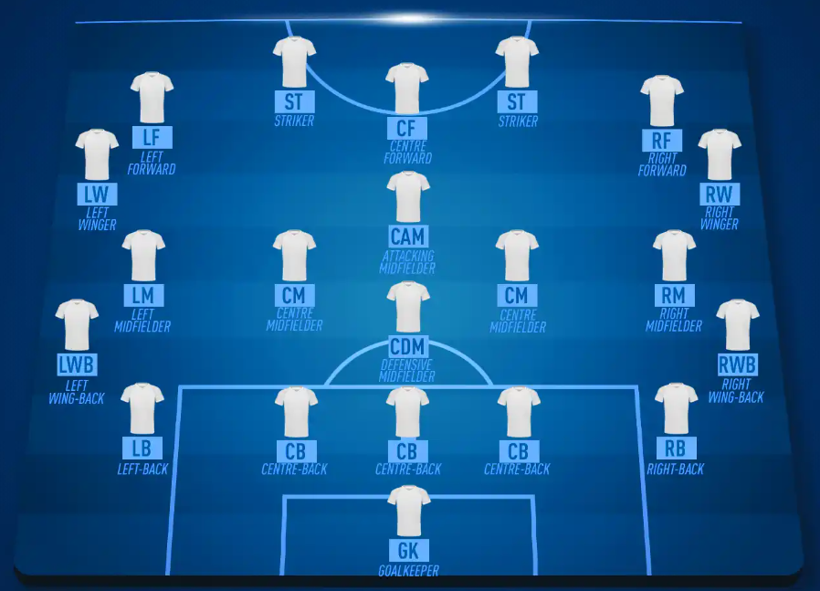
4.5 Label Clusters
>>cluster0 = Striker
>>cluster1 = Wing-defender
>>cluster2 = Center-back
>>cluster3 = Mid-field
>>cluster4 = Wing-attacker
0
4
4
3
1
1
2

Slide 14
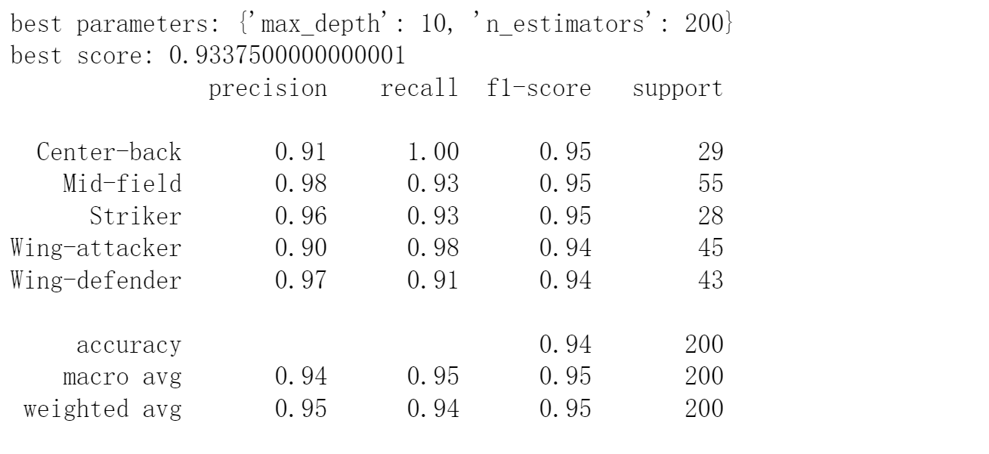
4.6 Random Forest Classifier
Random Forest achieved an overall accuracy of 94%.
For each position, the precision and recall were both over 90%.

Slide 15
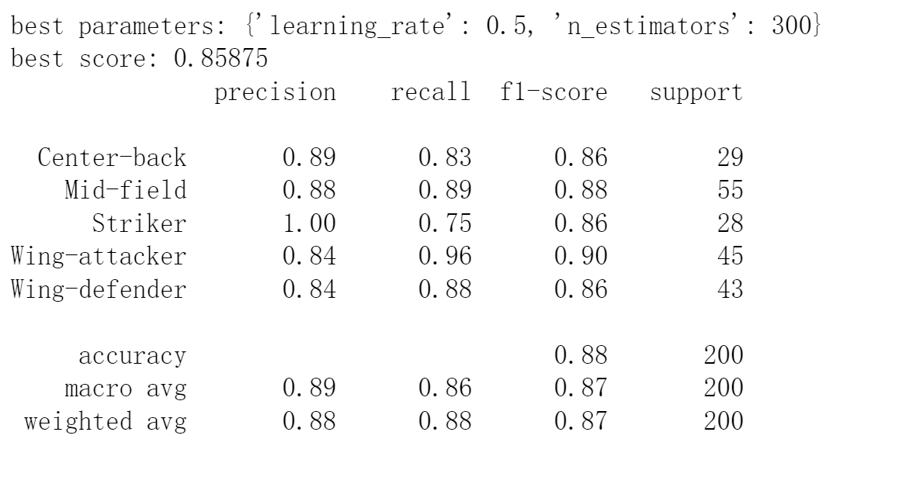
4.7 AdaBoost Classifier
Adaboost did not perform well on this dataset.
There was a large prediction bias for wing players, and there were significant misclassifications compared to forwards.

Slide 16
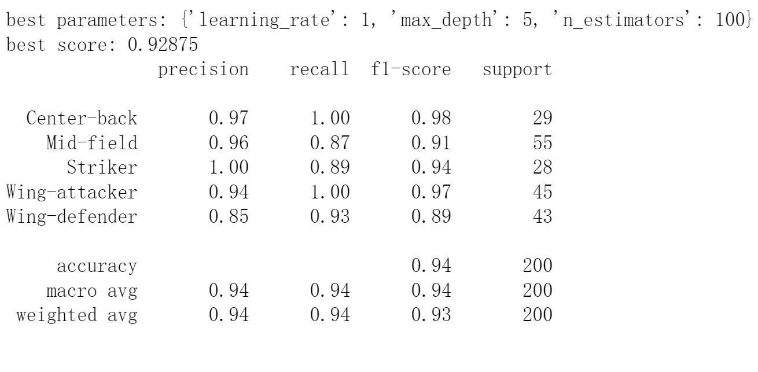
4.6 Gradient Boosting Classifier
The overall prediction accuracy of Gradient Boosting reached 94%.
However, the accuracy for wing-defender positions is relatively low.

Slide 17
4.8 Model Summary
Clustering
K-means performs better to explore the relationship between player attributes and positions.
Classification
Random Forest and Gradient Boosting successfully predicted the results of K-means clustering.

Slide 18
5. Final Conclusion
Data
The attributes of players in FIFA23 are consistent with the real world, and we can use classification to predict and prove the rationality of clustering.
Method
The natural distribution of the dataset may affect our analysis, but through continuous attempts and elimination, there is always a way to achieve or approach the goal.

Slide 19
Thank you for watching!

